Slide 1
Digital Portfolio
STUDENT NAME: D.MANIKANDAN
REGISTER NO AND NMID: 212402382 /ASUNM1301212402382
DEPARTMENT: BCA (bachelor of computer applications)
COLLEGE: AGURCHAND MANMULL JAIN COLLEGE

Slide 2
PROJECT TITLE
DIGITAL PORTFOLIO

Slide 3


AGENDA
Problem Statement
Project Overview
End Users
Tools and Technologies
Portfolio design and Layout
Features and Functionality
Results and Screenshots
Conclusion
Github Link
3/21/2024 Annual Review

Slide 4

PROBLEM STATEMENT
In today's competitive IT job market, creating a strong online presence is essential. Many professionals in the field struggle with presenting their work effectively. This website aims to provide a personal platform for D. Manikandan to showcase technical expertise and creative projects in web development and video editing.

Slide 5

PROJECT OVERVIEW
This project focuses on developing a personal portfolio website for showcasing skills, education, and expertise in the IT and web development field. The website is designed to provide a professional online presence, highlighting technical proficiency and creative work.

Slide 6

WHO ARE THE END USERS?
The primary users of this portfolio website are potential employers, clients, or collaborators in the IT, software development, and movie editing industries. The site aims to attract professionals who are looking for web development or digital media services.

Slide 7

TOOLS AND TECHNIQUES
The portfolio website is built using the following technologies:
Frontend: HTML, CSS, JavaScript
Backend (future development): Python, Java
Additional Tools: Visual Studio Code, GitHub for version control, Adobe Premiere Pro (for movie editing).

Slide 8
POTFOLIO DESIGN AND LAYOUT
The website’s design is minimalistic and user-friendly, featuring:
A clean, dark-themed layout that highlights the content.
A section for skills and expertise with visual indicators like progress bars.
An “About” section outlining educational background and career aspirations.
A contact form for easy communication.
8

Slide 9
FEATURES AND FUNCTIONALITY
Personal Branding: A custom design reflecting D. Manikandan’s IT and creative focus.
Skills Display: Progress bars to represent proficiency in programming languages like Java, C++, and Python.
Portfolio Section: Upcoming projects will be showcased here.
Contact Form: Users can send messages directly to D. Manikandan for inquiries.

Slide 10
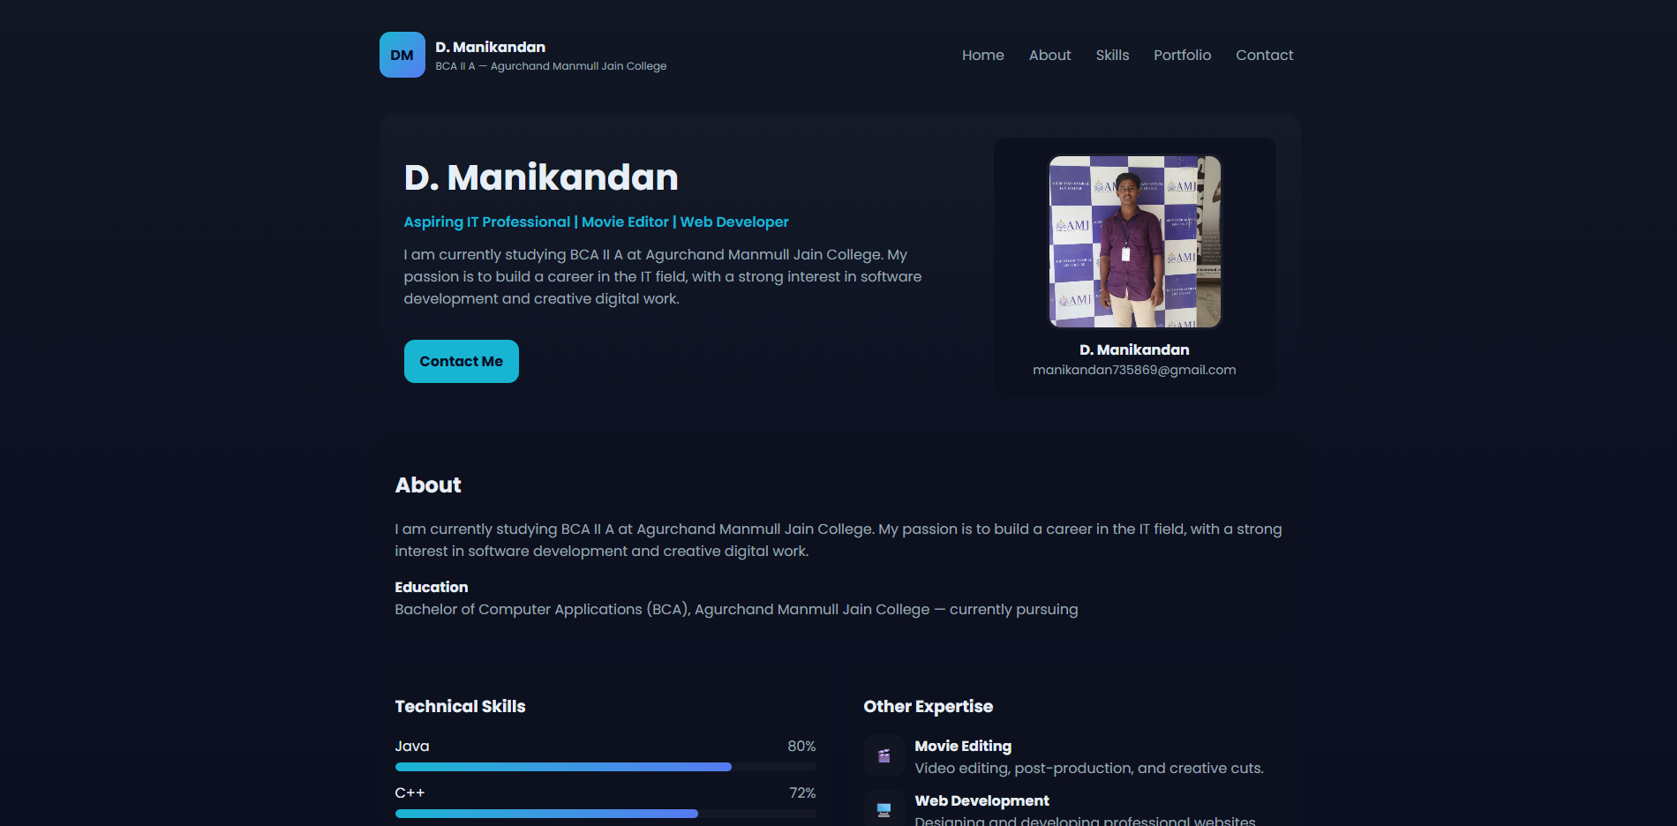

RESULTS AND SCREENSHOTS
The website successfully demonstrates the user’s technical abilities and creativity. Screenshots of the website, such as the homepage, "About" section, and skills dashboard, showcase its clean design and interactive elements.
3/21/2024 Annual Review
10

Slide 11
CONCLUSION
This project serves as a stepping stone in building an online presence. It reflects D. Manikandan's skills and passion for IT and digital work. The website is an effective tool for networking and professional growth in the IT industry.
11

Slide 12
Git hub repository link:
https://github.com/manikandan0707m-cmd/portfolio23.git
Github portfolio link
https://manikandan0707m-cmd.github.io/portfolio23/

